Slide 1

Heart
Disease
Prediction Model

Slide 2



Introduction
Download Heart Dataset from Kaggle.
The dataset contains health parameters indicating heart health.
Preprocess dataset for machine learning.
AI & ML model

Slide 3

Introduction
Split data into training and test sets.
Utilize machine learning algorithms: Logistic Regression, Random Forest, SVM, KNN, XG Boost.
Train model to predict heart disease presence.
Obtain trained model for heart disease prediction.
AI & ML model

Slide 4

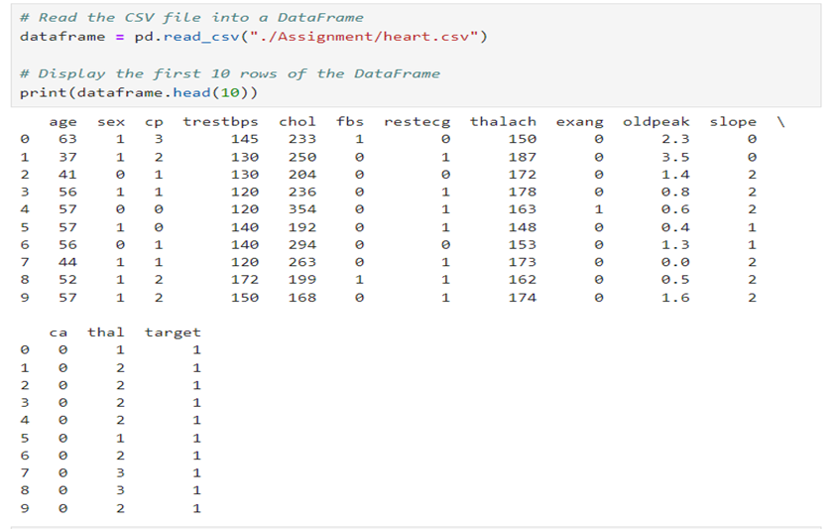
What factors influence the likelihood of heart disease in patients according to the dataset?
Determine factors influencing likelihood of heart disease.
Import libraries and dependencies.
Data collection and preprocessing: Upload CSV dataset to Pandas DataFrame.

Slide 5

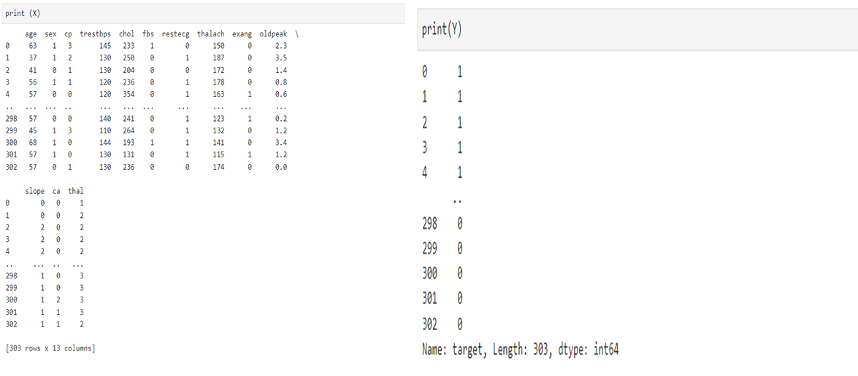
Basic information of DataFrame: 303 rows, 14 columns.
Check for missing values: df.isna().sum() --> No null values or duplicates found.
Data distribution: Healthy (0) and defective (1) heart values show a balanced distribution, so there is no need for further processing.
Split the data into Features and Targets.

Slide 6

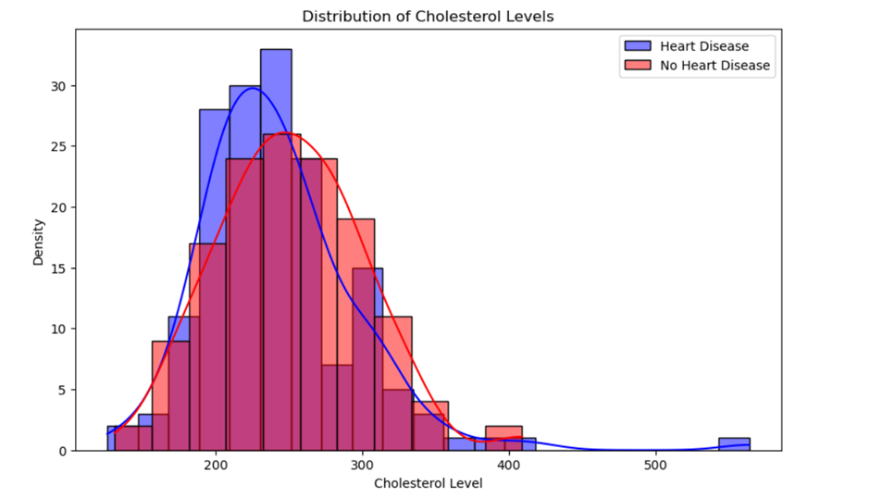


What is the distribution of cholesterol levels among patients with heart disease, and how does it compare to those without heart disease?
Filtered dataset into heart disease (target = 1) and without heart disease (target = 0) groups.
Set up plot figure and axis: plt.figure(figsize=(width, height)).
Plot density plot for cholesterol levels using sns.histplot().
Specify the cholesterol column and set color parameters to differentiate groups.

Slide 7

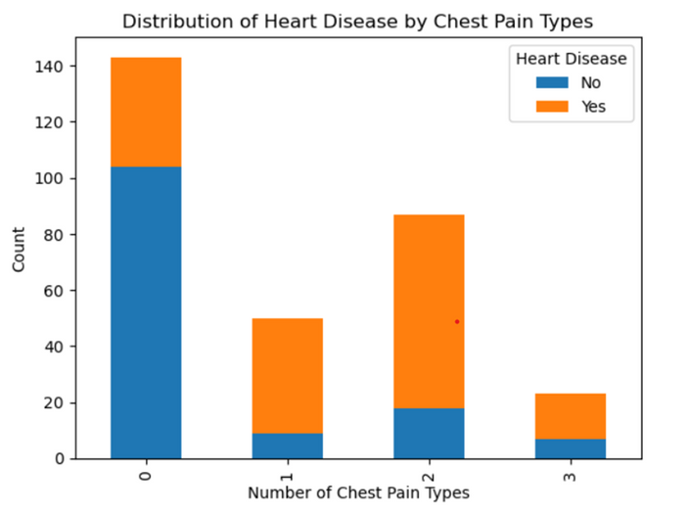


Is there a relationship between the number of chest pain types experienced by patients and the likelihood of heart disease?
Utilized visualization and statistical analysis to explore relationship between chest pain types and heart disease likelihood.
Approach: Created cross-tabulation between chest pain types (cp) and heart disease presence (target) using pd.crosstab().
Visualized cross-tabulation with stacked bar plot to observe relationship.
Findings
Type 0 chest pain had highest count of individuals without heart disease, while cp 2 had highest count of individuals with heart disease.

Slide 8
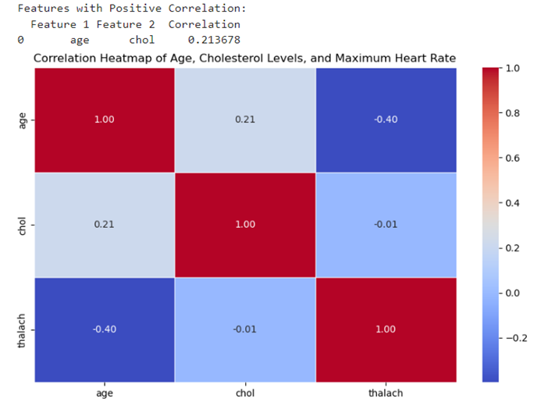

Can you use a heatmap to depict the correlation between different variables in the dataset, such as age, cholesterol levels, and maximum heart rate achieved?
Importance of identifying correlations between variables in dataset.
Generate heatmap to display correlation coefficients between age, cholesterol levels, and maximum heart rate achieved.
Interpretation of findings to understand relationships between variables.
Highest positive correlation: Age and cholesterol levels (0.2137).

Slide 9

Train-Test
Train set & Test set
Conduct train-test split: 80% train set, 20% test set.
Importance: Train classifiers on train set, evaluate model performance on test set.
Shapes of datasets:
X: (303, 13)
X_train: (242, 13)
X_test: (61, 13)

Slide 10
Model Development, Validation, and Evaluation
Importance of ongoing research and innovation in machine learning for heart disease forecasting and management.
Utilization of Scikit-Learn's model to estimate probability of heart disease occurrence.
Consideration of algorithm tuning for optimal outcomes.
Algorithms with highest accuracy levels deemed best for predictions.
Training

Slide 11

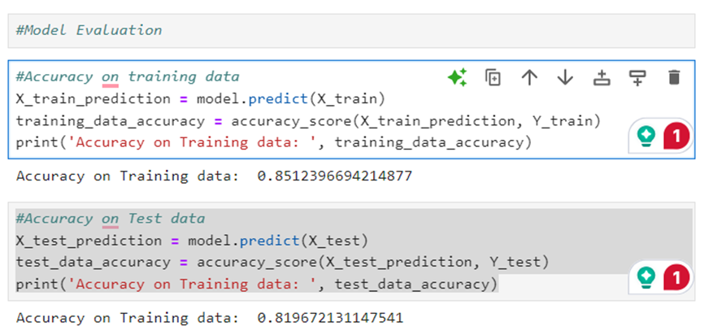
Logistic Regression
Prediction
Training Data Accuracy: 85%
Test Data Accuracy: 82%

Slide 12

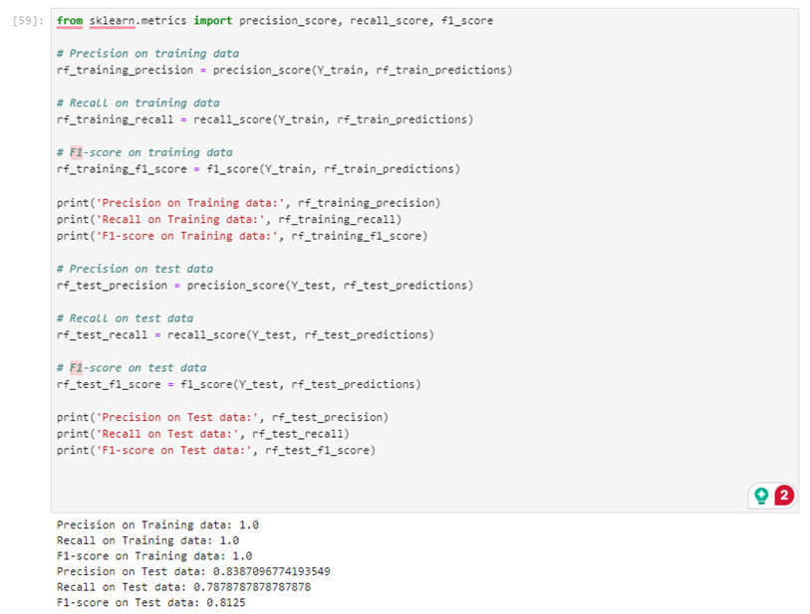
Random Forest
Prediction
Training
Precision 100%
Recall 100%
F1-score 100%
Test
Precision 83%
Recall 79%
F1-score 81%

Slide 13

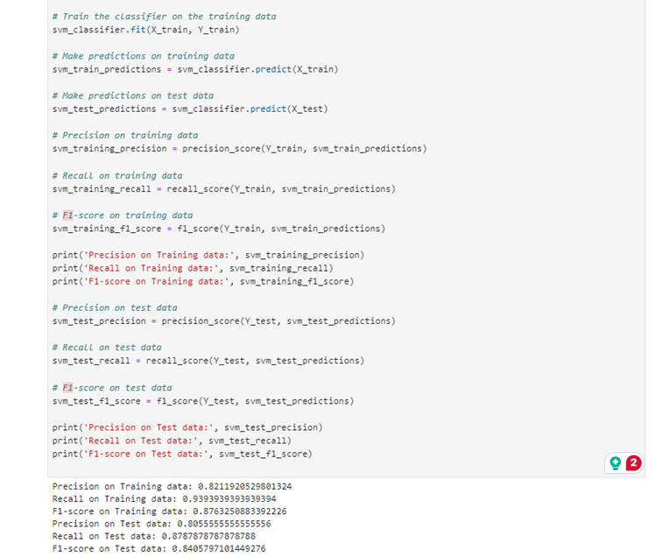
Support Vector
Prediction
Training
Precision 82%
Recall 94%
F1-score 88%
Test
Precision 80%
Recall 88%
F1-score 84%

Slide 14

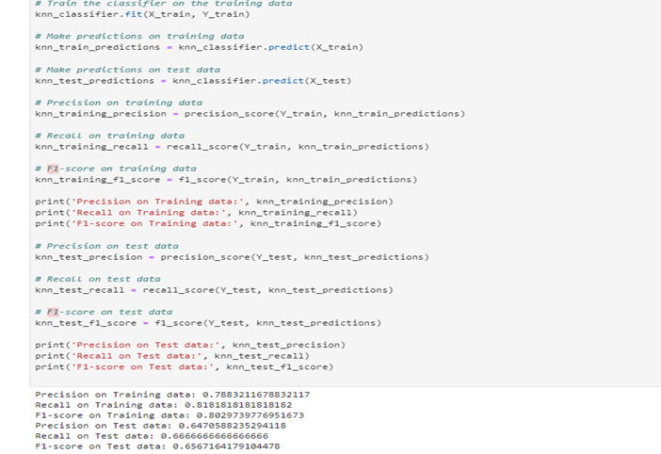
K-Nearest Neighbours
Prediction
Training
Precision 79%
Recall 81%
F1-score 80%
Test
Precision 64%
Recall 66%
F1-score 66%

Slide 15

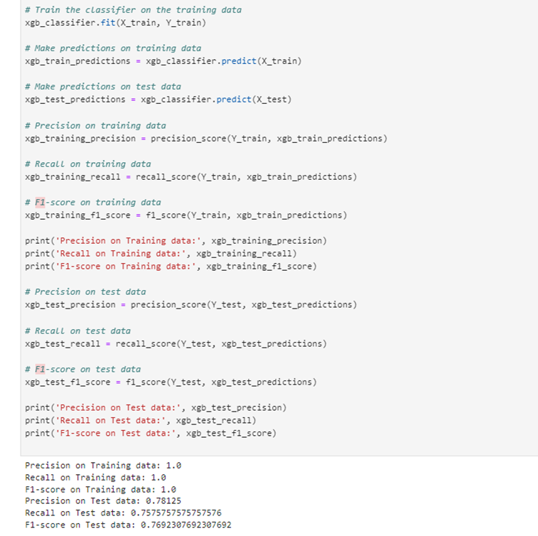
XG Boost
Prediction
Training
Precision 100%
Recall 100%
F1-score 100%
Test
Precision 78%
Recall 75%
F1-score 77%

Slide 16




Findings and Conclusion
Thorough evaluation of machine learning algorithms: Random Forest and XGBoost.
Superior performance in accuracy, precision, and F1-score were observed.
Random Forest was identified as the optimal model for heart disease prediction.
Integration of algorithm with Random Forest for accurate predictions.
Development of best-performing model.
Utilization of the Random Forest algorithm enables real-time prediction of heart disease.
Provides precise machine learning-based predictions for heart disease.

Slide 17

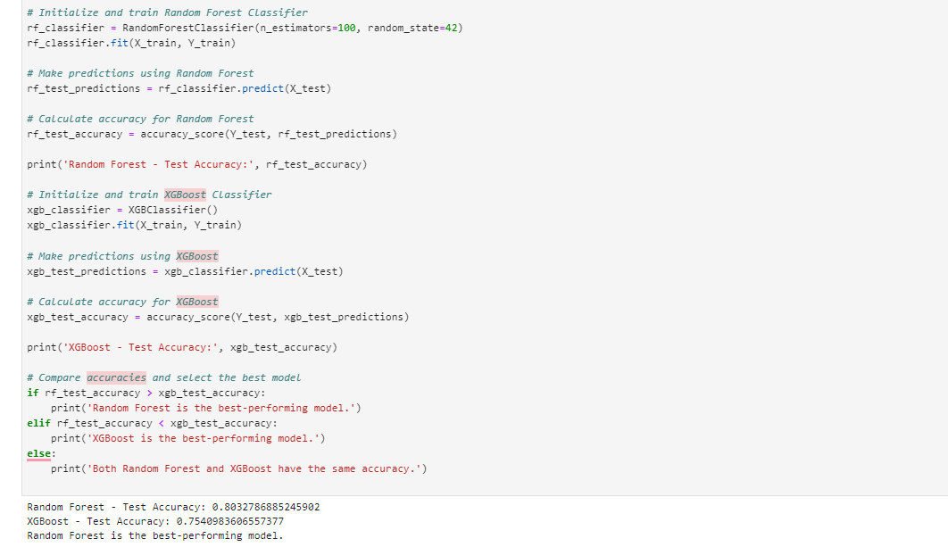
Comparing Random Forest and XG Boost
Random Forest - Test Accuracy: 0.8032786885245902
XGBoost - Test Accuracy: 0.7540983606557377
Random Forest is the best-performing model.

Slide 18

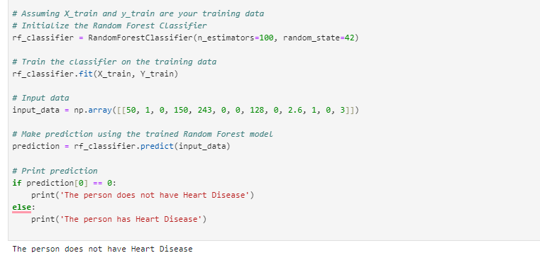
Random Forest Prediction Model
Input Data: 50, 1, 0, 150, 243, 0, 0, 128, 0, 2.6, 1, 0, 3
The model predicted that the person do not have heart disease

Slide 19
Thank
You
Any questions?

